Slide 1

Selenium
CSE-430
Maisha Mahajabin
Dept of CSE

Slide 2

What is Selenium
Selenium is open source browser optimization framework that is commonly used for writing and to end tests of Web applications.
Flexibility
‐ Multiple programming languages
‐ Multiple browsers
‐ Multiple OS
Parallel Testing - which reduces time and increases the efficiency of tests

Slide 3
Selenium tool suite
Selenium IDE
Selenium Remote Control
Firefox extension which provides record and playback functionality on test scripts.
Selenium IDE has limited scope and the generated test scripts are not very robust and portable
Allows testers to write automated web application UI test in any of the supported programming languages. Selenium RC comes with two components.
1.Selenium RC Server (acts as a HTTP proxy for web requests).
2.Selenium RC Client (library containing your programming language code).
1
2
3
Selenium WebDriver
4
Selenium Grid
Selenium 2.0 is the successor to Selenium RC
Allows to run tests simultaneously on different machines running different browsers and operating systems.

Slide 4
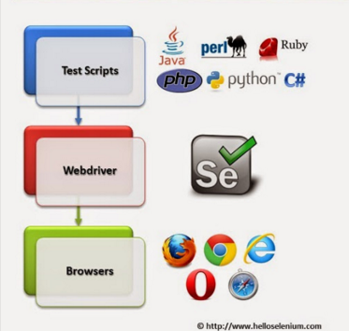
Selenium Webdriver/ Selenium 2.0
Provides a programming interface to create and execute test cases. Test scripts are written in order to identify web elements on web pages and then desired actions are performed on those elements.
Selenium WebDriver performs much faster as compared to Selenium RC because it makes direct calls to the web browsers. RC on the other hand needs an RC server to interact with the web browser..

Slide 5
Simply is a module/ API
Use to automate web application
Selenium Prerequisite
Python
IDE for python
Drivers ***

Slide 6
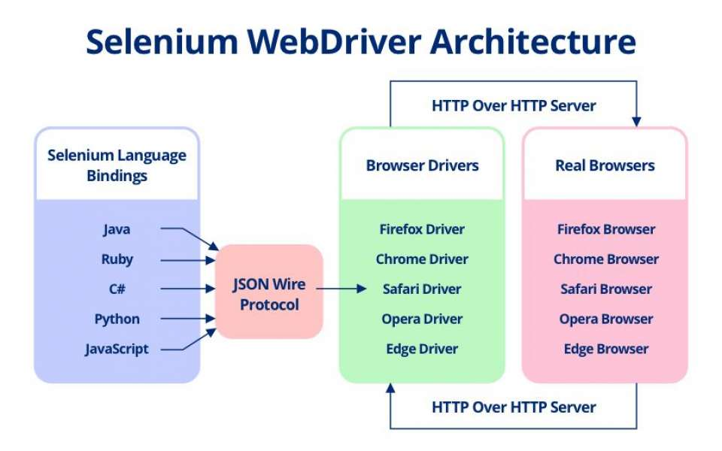

Slide 7
Test Case-1
Create object of webdriver
Navigate to google
Test Case-2
Navigate to demo.applitools page
Input username and password
login

Slide 8
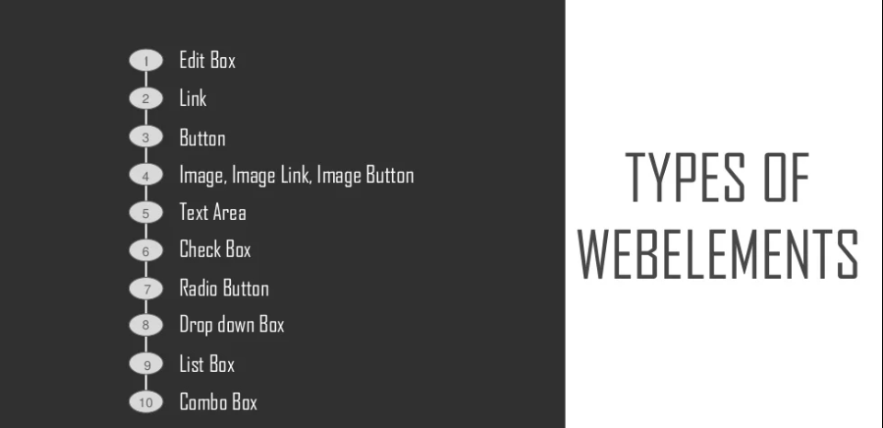
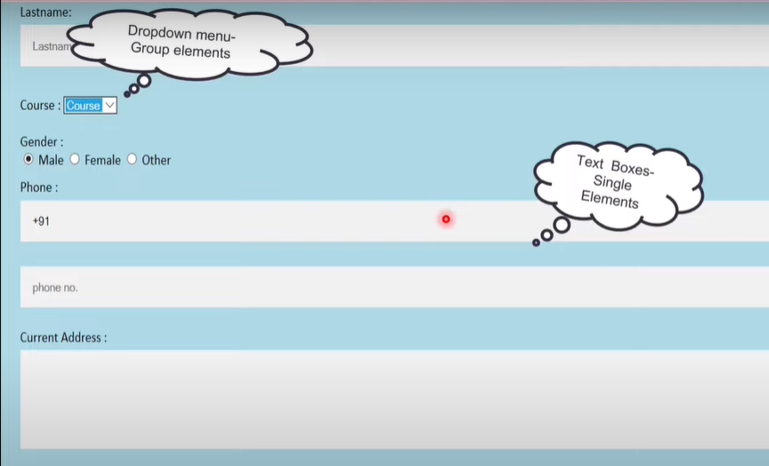
Web Elements
Anything on webpage is web element.
two types: single element , group element

Slide 9
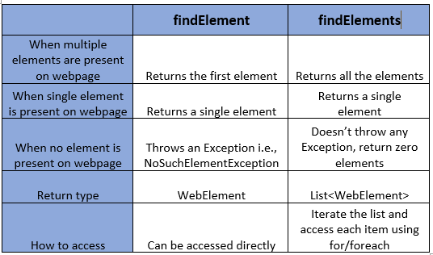

Slide 10
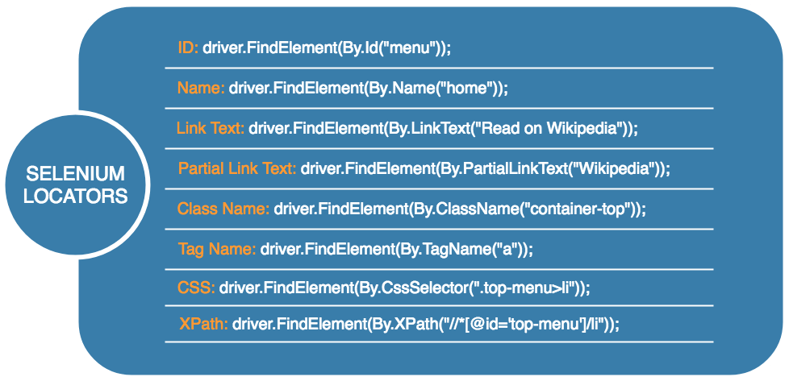

Slide 11
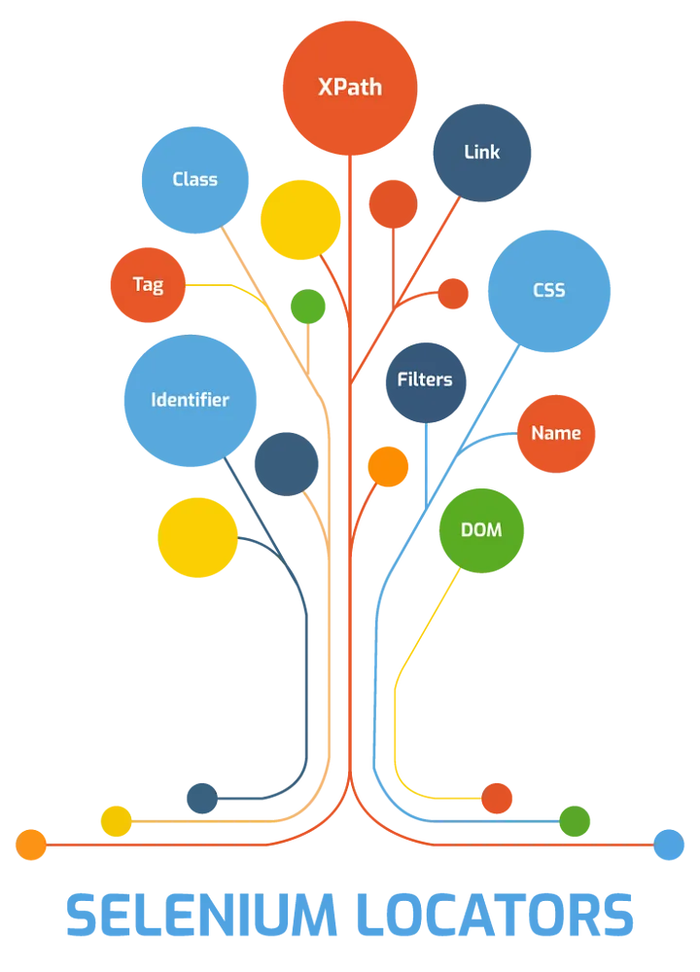
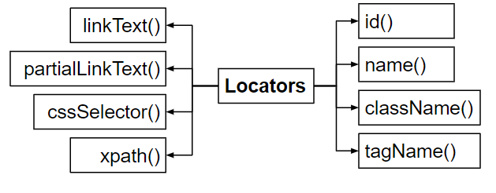
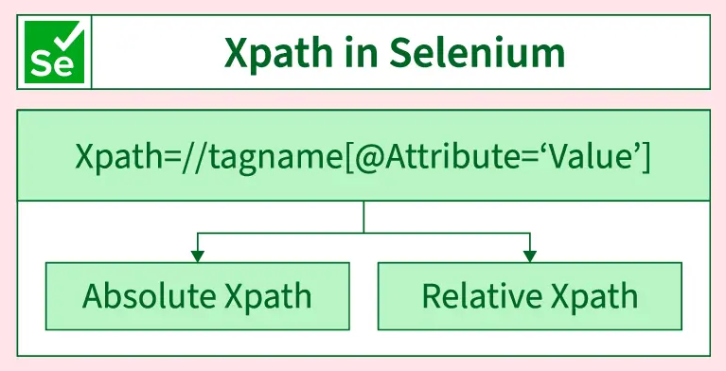
Locators
The way of identifying a web element on a web page

Slide 12
Test Case-3
Navigate to saucedemo website
Input username and password
Login
Located a product
Add to cart
Test Case-4
Navigate to local host website
Test successful logins

